Slide 1
Classification And Analysis of Road Accident News Articles Using Machine Learning
Under the supervision of:
Sakhawat Hossain Saimon Lecturer, Department of CSE, Metropolitan University.
Nusrat Farzana(151-115-106)
Foysol Ahmed Shuvo(151-115-120)

Slide 2
INTRODUCTION
Road accident is one of the major problems
Approximately 316,000 deaths each year(South-East Asia region)
In Bangladesh fatalities per 100,000 population is 13.6%
In 2017, 2297 people died and 5480 was injured in Bangladesh(January-June)
Causes of road accident
Rush Driving
Structure of road
Overtaking
Unaware pedestrian

Slide 3
PREVIOUS WORK
Measuring causalities
Chong, Miao & Abraham, Ajith & Paprzycki, Marcin. (2004)
Mining traffic data of N5 National highway in Bangladesh
M. S. Satu, S. Ahamed, F. Hossain, T. Akter and D. M. Farid (2017)
Analyzing road accident using roadside video data
M. M. L. Elahi, R. Yasir, M. A. Syrus, M. S. Q. Z. Nine, I. Hossain and N. Ahmed (2014)
Analyzing road accidents of only Dhaka city
Ahmed, Ishtiaque & Ahmed, Bayes. (2013)
Comparing road accidents of Dhaka with Bangladesh
Maniruzzaman, Khandoker & Mitra, Raktim. (2005)

Slide 4
OUR GOAL
Providing accident rates of all districts
Plotting data in heat-map
Vehicles analysis
Performance comparison of algorithms

Slide 5
METHODOLOGY
Refining
Analyzing vehicles
Heatmap
Categorizing
Crawling data
Extracting accident location
Extracting year
Accident statistics

Slide 6
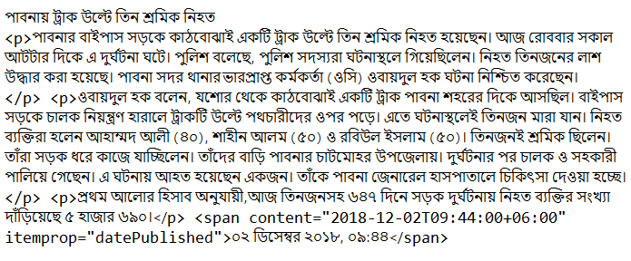
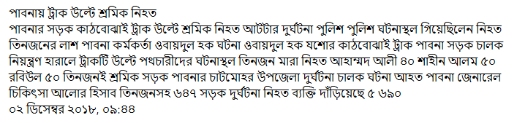
DATA COLLECTION & REFINING
Crawling data form Prothom-Alo
Refining crawled data
Figure: Initial crawled news
Keeping relevant data
ASCII to Unicode conversion
Indexing Root words
Eliminating Stop words
Tags Removing
Figure: News after refining

Slide 7
CLUSTERING NEWS ARTICLES
Different Types of Accidents
Algorithms Used for Clustering:
Building collapse
lightning strike
Sinking boat/ launch/ ship
Train Accidents
Drowning in the pond
Fire accidents
Animal attack
Cylinder blast
Naive Bayes Classifier
Cosine Similarity
Support Vector Machine

Slide 8
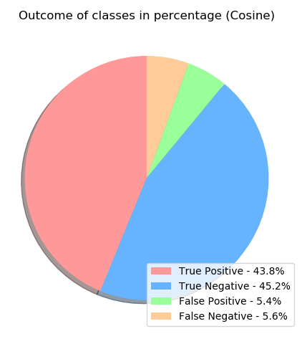
COSINE SIMILARITY
Measures similarity between two non-zero vectors.
Works better with large number of data.
Accuracy : 89%
Measures similarity between two non-zero vectors.
Works better with large number of data.
Accuracy : 89%
Fig: Outcome rate of classes
(Cosine Similarity)

Slide 9
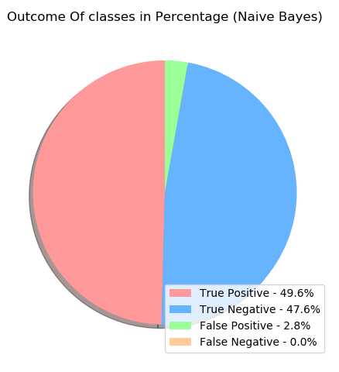
NAIVE BAYES CLASSIFIER
Simple probabilistic classifier
Use Bayes theorem
Accuracy: 97.2%
Simple probabilistic classifier
Use Bayes theorem
Accuracy: 97.2%
Fig: Outcome rate of classes(Naive Bayes)

Slide 10
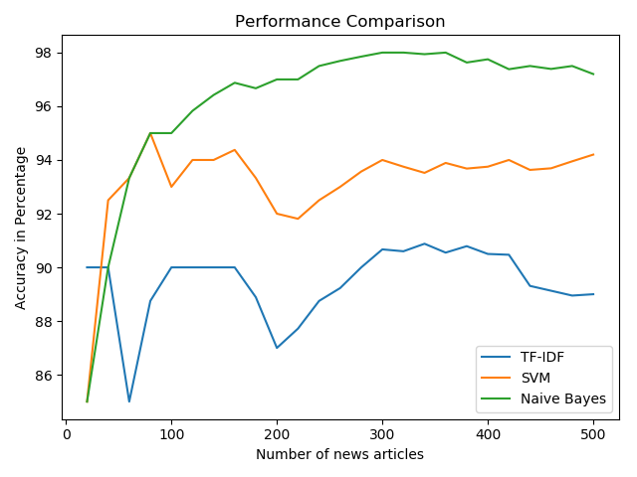
Performance Comparison of Algorithms
Performance of Naive Bayes increase with data
SVM shows better performance than Cosine Similarity
Cosine Similarity shows the least performance
Performance of Naive Bayes increase with data
SVM shows better performance than Cosine Similarity
Cosine Similarity shows the least performance
Fig: Comparison between Naive Bayes, Cosine Similarity and SVM

Slide 11
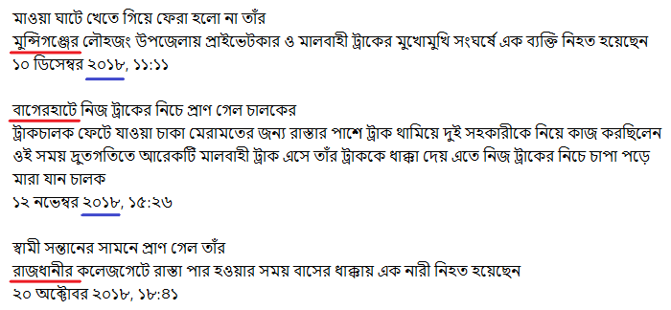
LOCATION AND YEAR EXTRACTION
Location can be at the beginning of news
Location can be at the beginning of heading
Dhaka sometimes referred as Rajdhani
Year of accident always at the 3rd word
Location can be at the beginning of news
Location can be at the beginning of heading
Dhaka sometimes referred as Rajdhani
Year of accident always at the 3rd word
Fig: Some news of accidents

Slide 12
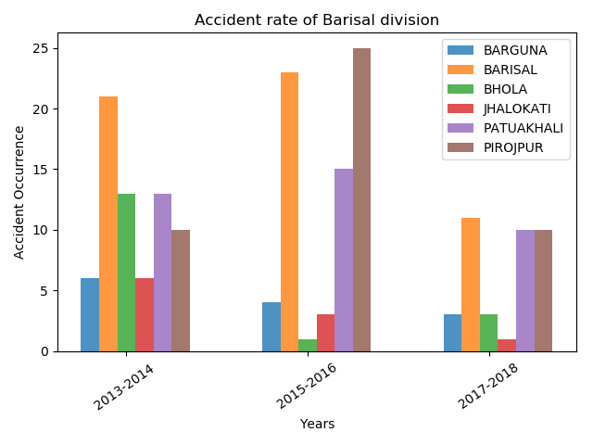
RESULT AND DISCUSSION
In year 13-14 Barishal district was most accident occuring location
In year 15-16 rate of accident increased and Pirojpur was most accident occuring district
In year 17-18 accident rate decreased again Barsiha district was most accident occuring location
Year 2013-14:
Most road accidents occurred in Barishal districts
Year 2015-16:
Rate Decreased: Barguna,Bhola,Jhalokati
Rate increased: Barishal,Patuakhali,pirojpur
Most road accident occurred in Pirojpur
Year 2017-18:
Accident rate decreased a lot
Increased rate in Bhola
Fig: Bar diagram of accidents
(Barishal Division)

Slide 13
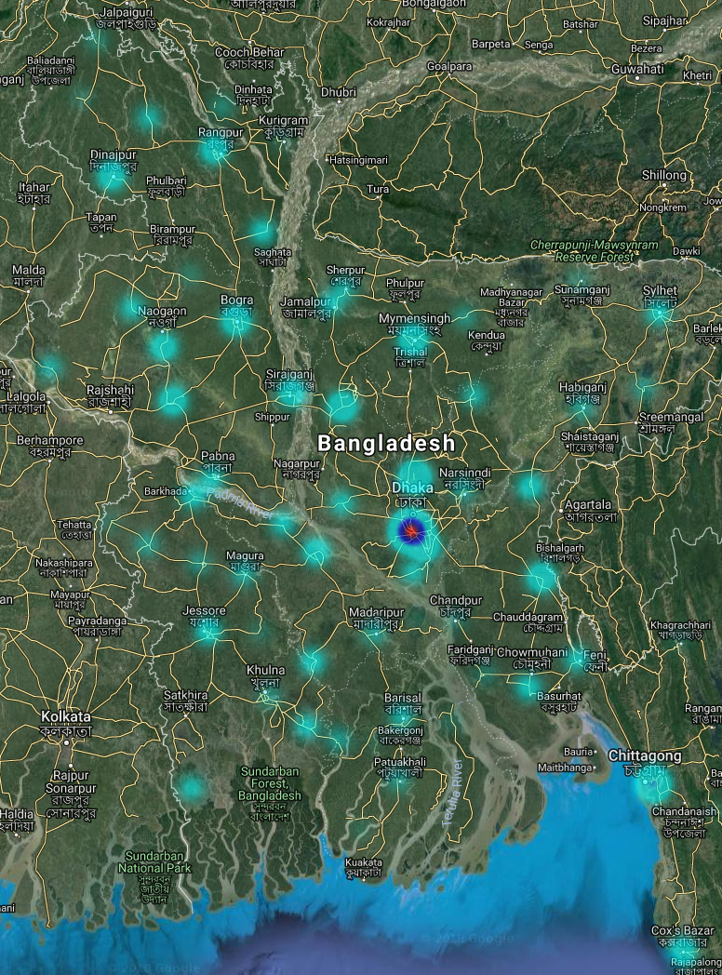
HEAT MAP
A Heatmap is a graphical representation of data.
Plots a data depending on given Latitude, Longitude and a weight
Number of accidents of district used as weight.

Slide 14
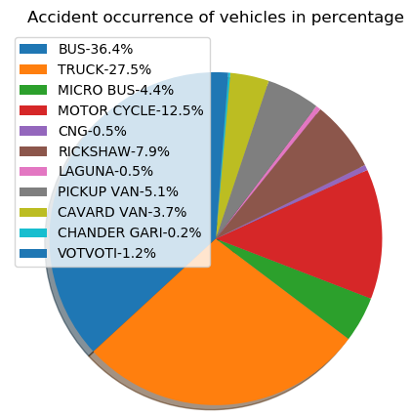
VEHICLES ANALYSIS
News Contains name of one or multiple vehicles involved with accident
Bus and Trucks are mostly involved with accidents
In total 63.9% of the total road accidents are caused by Buses and Trucks
News Contains name of one or multiple vehicles involved with accident
Bus and Trucks are mostly involved with accidents
In total 63.9% of the total road accidents are caused by Buses and Trucks
Fig: pie-chart of the accident occurring based on vehicle

Slide 15
CONCLUSION
Analyzing our research, authority might get help to reduce road accidents by:
Building foot over bridge
Making the roads one way where needed
Building fly over
Making strict rules for some vehicles and etc.

Slide 16
LIMITATION
Used only Prothom-Alo as resource
Our work is only districts and division based
More patterns for extracting locations might be necessary for different newspapers

Slide 17
FUTURE WORK
Automating the process
Analyzing causalities
Using more resources
Sub-districts based statistics

Slide 18
Questions?
Thank You!

